Slide 1
Intro to Pandas

Slide 2
Let’s Review What We Learned Yesterday
Mean → gives us an idea of the middle or center of the data distribution. Be careful with outliers!
Median → gives us an idea of the midpoint of the data and what falls above and below the midpoint. Less sensitive to outliers.
Mode → the most frequent value in your data set
Range → tells you how similar or varied the data is
Standard Deviation → describes how spread out the data set is (low SD - values are close to the mean while high SD - values are spread out)
Histograms → show how often values show up in data. Data is split into equal groups called bins

Slide 3
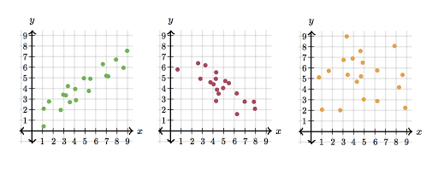
Let’s Review What We Learned Yesterday
Linear regression → creating a line of best fit through a set of data points
The line of best fit most accurately captures the pattern that exists within the data points that you have
Linear regression is very helpful for making predictions
R → correlation coefficient (a measure of
How related two variables are to each
other)
R^2 → how much do the data points vary together
Correlation (r) is related to slope through an equation; however, it doesn’t necessarily mean that the steeper the slope the higher the correlation
Why linear regression is useful: to see which variables are correlated and to predict values

Slide 4

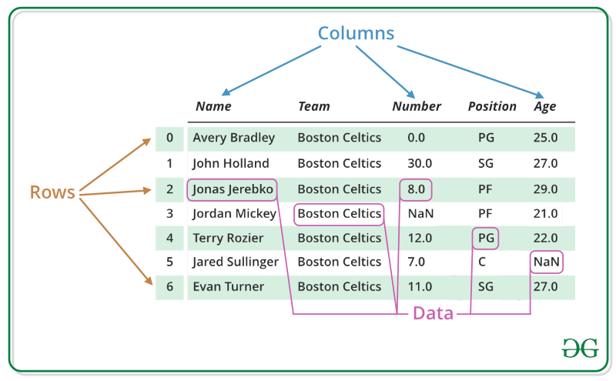
pandas
Library that allows us to work with data sets.
It has functions for analyzing, cleaning, exploring, and manipulating data.
Data is often read into dataframes (tables with rows and columns)
Notes:
import ____ as __
import pandas as pd

Slide 5
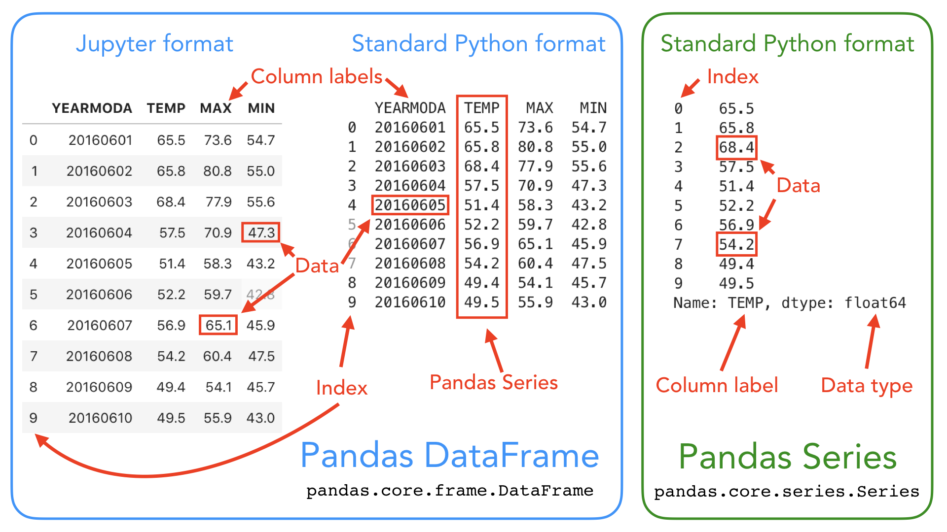
Series vs. Dataframes
Series - single list with an index. Can perform operations like you could with an array.
Dataframe - collection of series in a table format.

Slide 6
Importing data files
The data we will work with is often stored in csv (“comma separated value”) files - the data is separated by commas
Use the pandas function read_csv() to read in files
Example - reading in a file called data.csv:
data = read_csv(“data.csv”)
We store the data read from the file into a dataframe variable called data
Filename must be passed in as a string (don’t forget quotation marks!)

Slide 7
Importing data files
Example - what if the file data.csv is saved in a different folder, called ‘datasets’?
data = read_csv(“datasets/data.csv”)
Include the folder name before the filename, and add a slash

Slide 8

Exploratory Data Analysis (EDA)
Try to make sense of data on hand
Initial investigations of data
Trying to summarize main characteristics and identify patterns in data

Slide 9
Functions for Exploring your Data Frame
DataFrame.head(n) - returns the first n rows, snapshot of the data
DataFrame.tail(n) - returns the last n rows, snapshot of the data
 | name | address | age
1 | n1 | ad1 | a1
2 | n2 | ad2 | a2
3 | n3 | ad3 | a3
4 | n4 | ad4 | a4
5 | n5 | ad5 | a5
 | name | address | age
101 | n101 | ad101 | a101
102 | n102 | ad102 | a102
103 | n103 | ad103 | a103
104 | n104 | ad104 | a104
105 | n105 | ad105 | a105
Notes:
If you don’t put anything within the parentheses, defaults to 5

Slide 10
Functions for Exploring your Data Frame
DataFrame.shape
Outputs n rows and m columns
DataFrame.columns
Outputs names of columns
len(DataFrame)
Gives number of rows of dataframe
DataFrame.info()
Outputs info per column, such as the format of data in each column, the number of Null (or missing) values per column, etc.

Slide 11

In notebook 06_intro-to-pandas, complete the following section:
1.1 - Importing Data

Slide 12
Calculating Statistics!
DataFrame.describe()
Basic statistics about each of the variables in your DataFrame, such as mean, standard deviation, min/max values, etc.
Use the argument include=’all’ to also work with non-numeric data.
For example, if the column is not numeric, it will return measures such as count, number of unique values, and the most frequent value (top is the value of the most frequent value, while freq tells you its frequency).

Slide 13
Statistics!
DataFrame.describe()
Basic statistics about each of the variables in your DataFrame, such as mean, standard deviation, min/max values, etc.
Use the argument include=’all’ to also work with non-numeric data. You will get measures such as the number of unique values, the most frequent value (top is the value of the most frequent value, while freq tells you its frequency).

Slide 14
Calculating Statistics!
DataFrame.mean() [OR .median(), .mode(), .std(), etc.]
You can also directly get various statistics measurements
Note that you may get a warning if your dataframe contains non-numeric columns (e.g. strings). A warning is not an error and it is completely fine.
To get around it, you can use the argument ‘numeric_only=True’ OR specify which column to look at (which we will learn in the next notebook!)

Slide 15
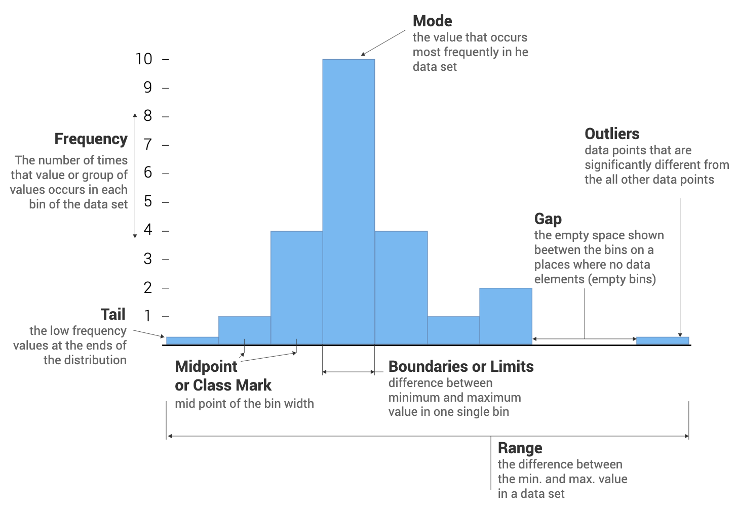
More Statistics!
Each bin is a bar whose height corresponds to how many data points are in that bin.
DataFrame.hist()
Pandas can quickly create histograms
It will choose the bin size automatically but you can change it using the bins= argument

Slide 16
In notebook 06_intro-to-pandas complete the following sections:
1.2 - Statistics
1.3 - Histograms and Standard Deviation
When you are done, complete the Exit Ticket!
Notes:
Stop here. Keep Slides 15 on as reference as the slides are covered in lesson 07 Pandas Dataframes

Slide 17
Indexing!
Two main ways to index into Pandas Dataframe
Loc
Uses column/row labels to index into the table
.loc[rows-label(s),columns-label(s)]
Iloc
Uses column/row indices to index into the table
.iloc[row-index, column index]

Slide 18

Indexing!
In order to just get a column
Dataframe[“column name”], returns series
Dataframe[[“column name(s)”]], returns dataframe
You can get one row, multiple rows, one column, all columns,...
There are so many different ways, we want you to try them for yourself!!

Slide 19
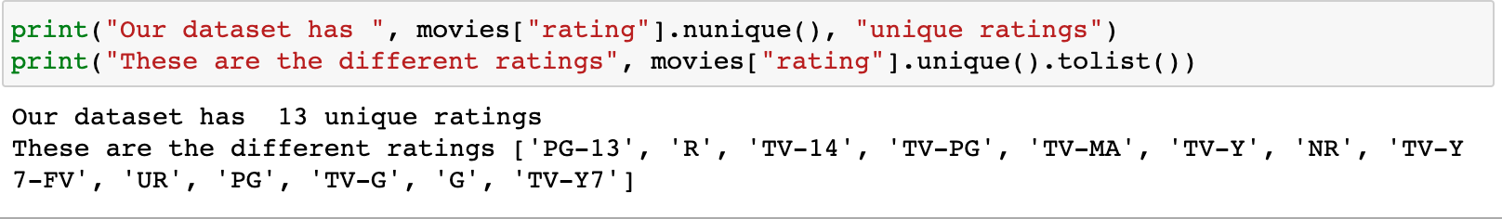
Uniqueness
Dataframe[“column name”].unique()
Returns the unique values in that column
Dataframe[“column name”].nunique()
Returns number of unique values in a column

Slide 20
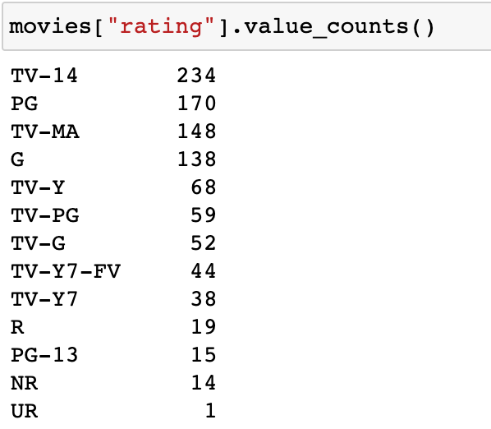
Frequencies
Dataframe[“column name”].value_counts()
Returns the counts for the unique values in our column

Slide 21
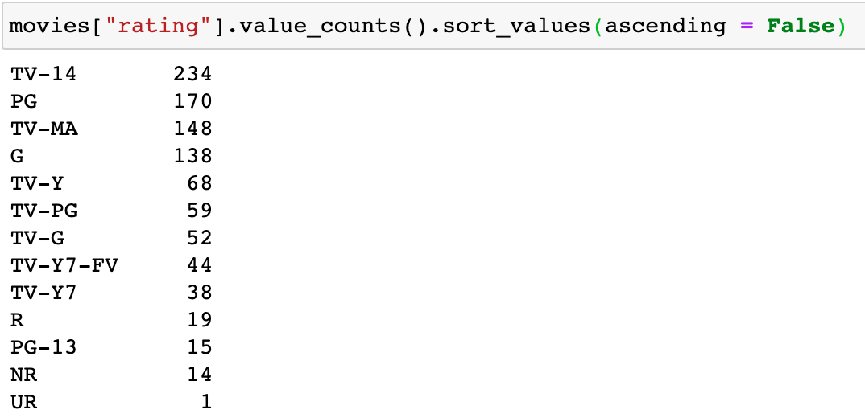
Sorting
Pandas sort values in an “ascending” order
Ascending: from low to high
To sort in descending order (high to low), you have to specify “ascending = False)
You can sort by the index (the index being either alphabetical like our example or numerical)

Slide 22
Finding Range - Min/Max
Finding min:
Dataframe[“column name”].min()
min(Dataframe[“column name”])
Any guesses on finding the max?
How would we then find range?

Slide 23
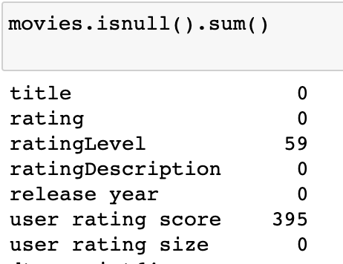
Null Values
Null values occur when there is no data for that specific datapoint
“Nan”
“Null”
Or even values that make no sense (-9999 for a zip code, “” for a city name, etc.)
Dataframe.isnull().sum()
Returns number of null values for each column
Dataframe[“column_name”].isnull().sum()
Returns number of null values for specified column
Why might values be null in a dataset??

Slide 24
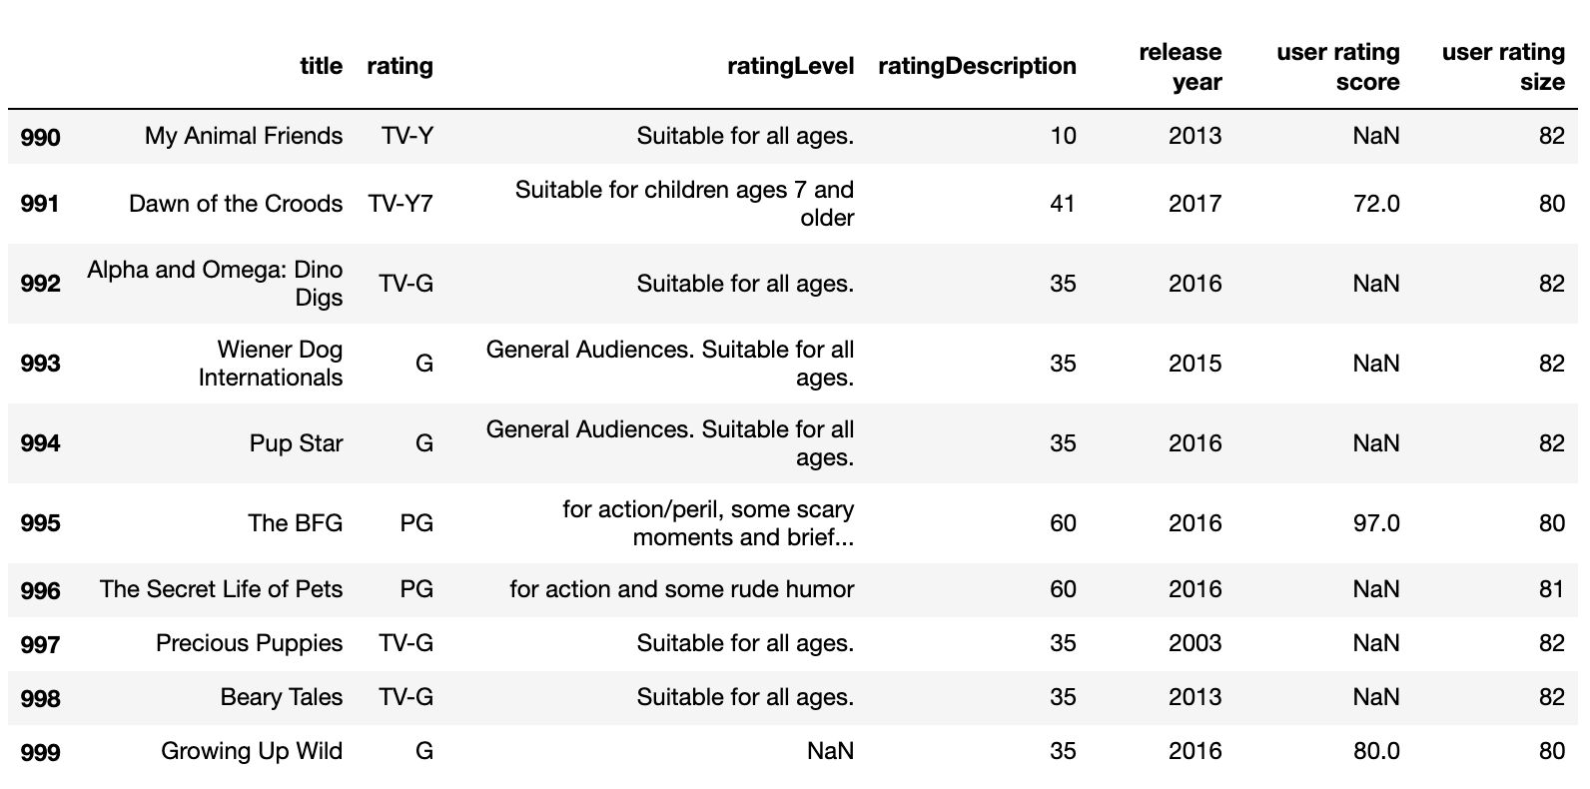
Null Values - Practice
What would be the output of:
movies[“user rating score”].isnull().sum()

Slide 25

Practice time!
Section 1.2 (Uniqueness) to 1.6 (Missing Values)

Slide 26
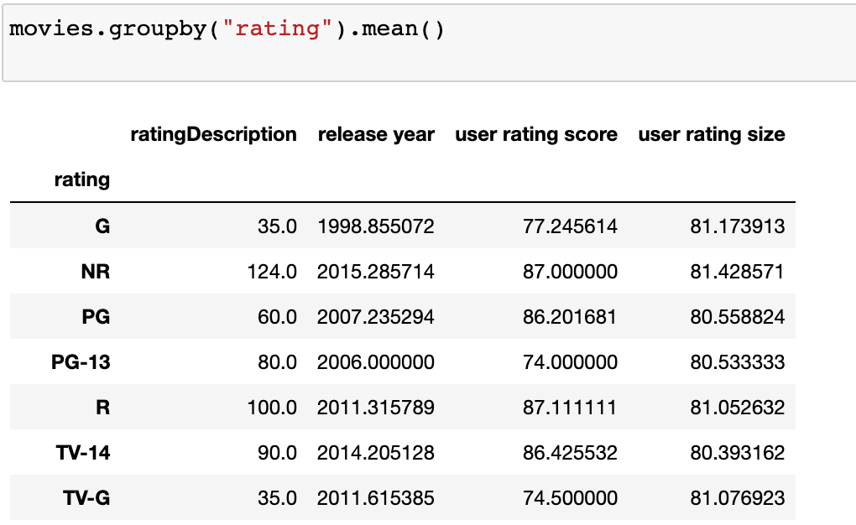
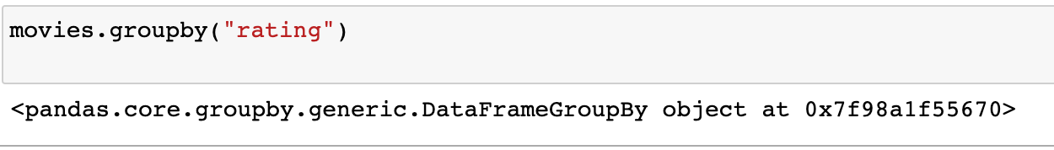
GroupBy
It can be really insightful to group a dataset by a certain column
For example, we could look at movies that were released in the same year, movies that have the same rating, …
When you group a table, you must choose a function to apply your grouping by
Functions include: count, mean, sum, max, etc.
NOTICE: when you do not use a function, there is no output

Slide 27
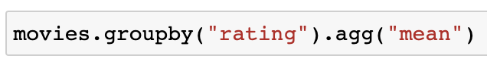
GroupBy
Two ways to call groupby:
Writing the function after groupby
Writing .agg() after groupby and writing the function within the parentheses (as a string)

Slide 28
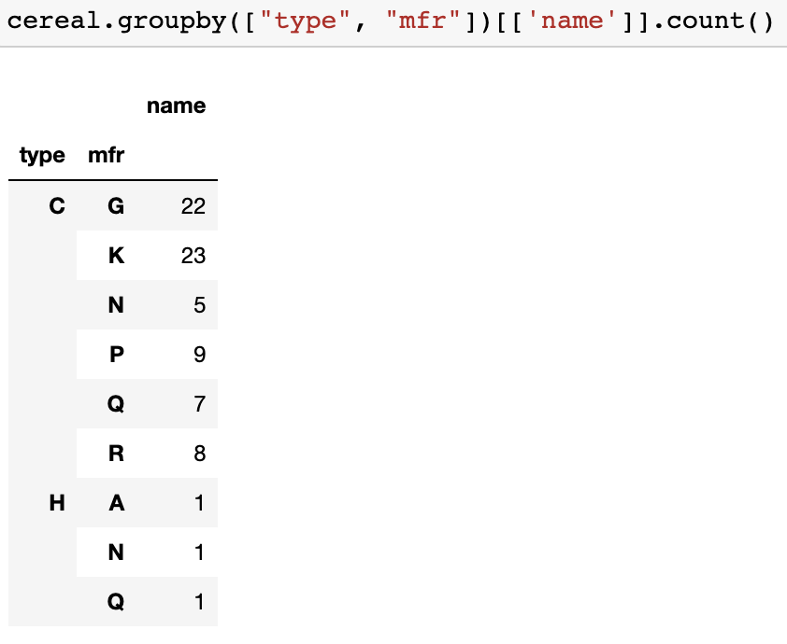
GroupBy
You can also group by multiple columns. Make sure the multiple columns are passed in as a list
Notice the list of columns!

Slide 29
Practice time!
Section 1.7 (GroupBy)

Slide 30
Boolean Indexing
Review: What are the two types of boolean values?
Boolean indexing lets you access a subset of the data that meets a certain condition.

Slide 31
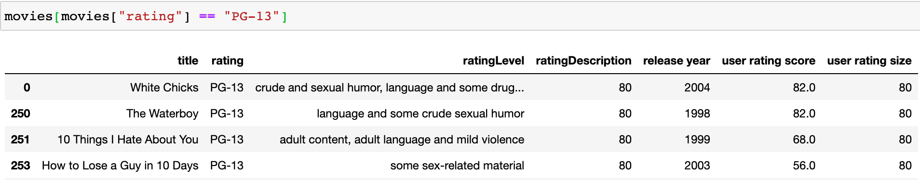
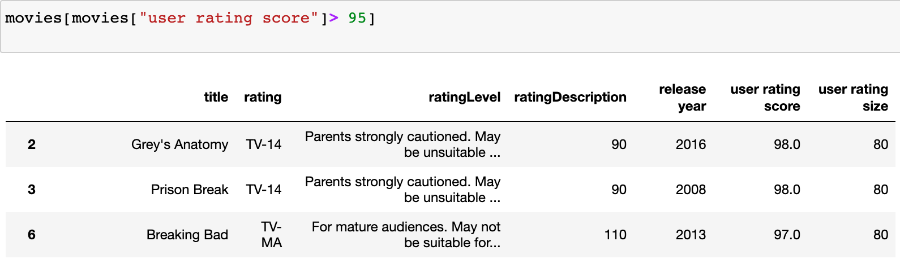
Boolean Indexing - Examples
What condition does the below subset of movies follow?
What condition does the below subset of movies follow?

Slide 32
Boolean Indexing - Multiple Conditions
And (&)
Returns only rows where both conditions are met
Example: dataframe[(dataframe[“column name”] == this) & (dataframe[“column name”] < 20)]
Or (|)
Returns rows where either conditions are met
Example: dataframe[(dataframe[“column name”] == this) | (dataframe[“column name”] < 20)]

Slide 33
Boolean Indexing - Multiple Conditions
Example:
You filter the movies dataframe in two different ways:
movies[(movies[“rating”] == “G”) & (movies[“user rating score”] < 20)]
movies[(movies[“rating”] == “G”) | (movies[“user rating score”] < 20)]
Which dataframe will have more rows? Why?

Slide 34
Practice time!
Section 2 (Boolean Indexing)

